Slide 1
CSC – 183 Programming C
Chapter - 6
Decision Making and Looping

Slide 2
Chapter Outline:
Looping statements in C
for loop
while loop
do-while loop
Jump Statements in C
continue
break
goto

Slide 3
Introduction
It is possible to execute a segment of a program repeatedly by introducing a counter and later testing it using the if statement.
……
sum = 0;
n = 1;
loop:
sum = sum + n;
if(n == 10)
goto print;
else
{
n = n + 1;
goto loop;
}
print:
……
This program does following things:
Initializes the variable n
Computes the summation by adding n with sum.
Tests the value of n to see whether it is equal to 10 or not.
If equal, goto the print
If not equal, increment the value of n by one, and goto the loop again and add n with sum.
Repeat this until the value of n equal to 10.

Slide 9
for(initial value ; condition; increment/decrement )//control statement
{
printf();//body
}
3 parts of a for loop
Initialization
Condition
Inc/dec

Slide 10
Introduction
One of the fundamental properties of a programming language is the ability to repetitively execute a sequence of statements which is called decision making and looping. “Decision making and looping” is one of the most important concepts of computer programming.
Programs should be able to make decisions based on the condition provided and then repeat a specific chunk of code or statement again and again.
These looping capabilities enable programmers to develop concise programs containing repetitive processes that could otherwise require an excessive number of statements.
It enable us to repeat a specific section of code or statement without the use of goto statements .
In looping a sequence of statements are executed until some conditions for termination of loop are satisfied.

Slide 11
Loop Segments
In looping a sequence of statements are executed until some conditions for termination of loop are satisfied.
A program loop therefore consists of two segments.
One known as the body of the loop and the other known as the control statement.
The control statement tests certain conditions and then directs the repeated execution of the statements contained in the body of the loop.

Slide 12
Looping statements in C
The C language supports three types of looping statement:
for loop
while loop
do-while loop
Steps of Looping a Process:
A looping process, in general, would include the following four
steps. The given steps may come at any order depending on the
type of the loop.
Initialization of a condition variable. i = 0/i=1
Test for a specified value of the condition variable for execution of the loop. A<5/i<8
Execution of the statements of the loop. Printf()
Increment or decrement (update) the condition variable. i++,i--

Slide 13
The for statement (for loop)
The for loop is an entry-controlled loop that provides a more concise loop control structure.
General Format:
for(initialization ; test-condition ; increment/decrement)
{
statements; //body of the loop
}
The execution of the for statement is as follows:
Initialization of the control variables is done first.
The value of the control variable is tested using the test-condition.
If test-condition true the body of the loop is executed; otherwise the loop is terminated.
When the body of the loop executed, the control is transferred back to the for statement after executed body part. Then increase or decrease the value of control variable.

Slide 14
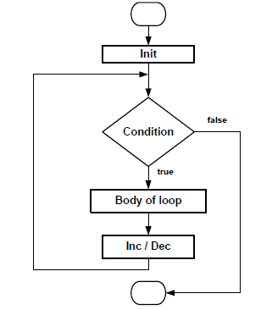
The for statement (for loop)
General Format:
for(initialization ; test-condition ; increment/decrement)
{
statements; //body of the loop
}

Slide 15
Analyze the for Statement
for The keyword of for loop
Initialization Set the initial value of the loop control variable
Test-condition Set the condition to control the loop via loop control variable
Inc/dec Update the value of the loop control variable
Body of the loop Statements to be executed or controlled under the for loop

Slide 16
The for statement (for loop)
** Program using for loop:
#include<stdio.h>
int main()
{
int n, sum = 0;
for(n=1 ; n<=10 ; n=n+1)
{
sum = sum + n;
}
printf("The summation is: %d",sum);
return 0;
}
Output:
The summation is: 55

Slide 17
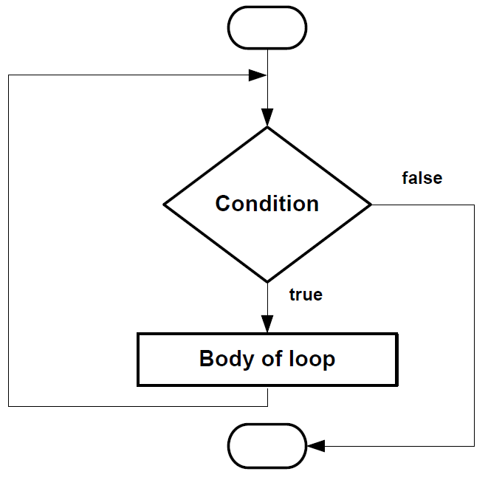
The while statement (while statement)
General Format:
while( test-condition )
{
statements; //body of the loop
}

Slide 18
The while statement (while statement)
The simplest of all the looping structures is the while statement.
The while is an entry controlled loop statement.
while also called sentinel-controlled loop.
The test-condition is evaluated and if the condition is true, then the body of the loop is executed.
After execution of the body the test condition is once again evaluated and if it is true, the body is executed once again.
This process of repeated execution of the body continues until the test condition becomes false and the control is transferred out of the loop.
The important thing to notice that if the test condition is false then the controlled statements are not executed not even once unlike the do while loop.

Slide 19
The while statement (while statement)
** Program using while loop:
#include<stdio.h>
int main()
{
int n, sum = 0;
n = 1;
while(n<=10)
{
sum = sum + n;
n = n + 1;
}
printf("The summation is: %d", sum);
return 0;
}
Output: The summation is: 55

Slide 20
The while statement (while statement)
Program to find out x^{n} (x to the power n). Where, x is base, n is power.
int main()
{
int count, n;
float x, y = 1.0;
printf(“ Enter the values of x and n ”);
scanf(“%f %d”, &x, &n);
count = 1;
while( count <= n )
{
y = y * x;
count++;
}
printf(“ x to power n = %f ", y;
return 0;
}

Slide 21
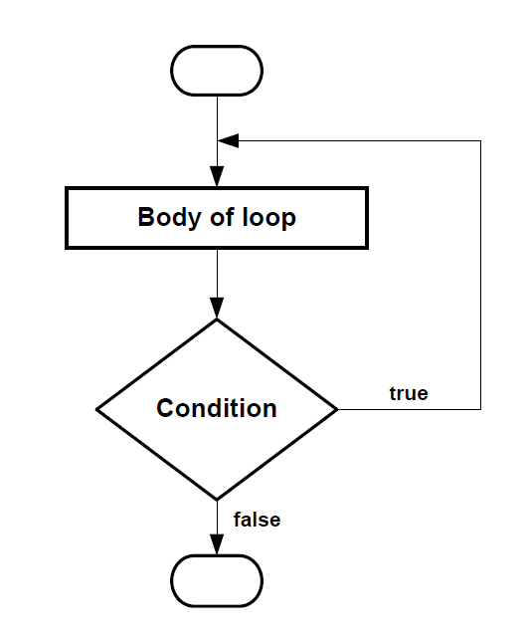
The do statement (do while loop)
General Format:
do
{
statements; //body of the loop
}
while( condition );

Slide 22
The do statement (do while loop)
On some occasions it might be necessary to execute the body of the loop before the test is performed. Such situations can be handled by using do while loop.

Slide 23
The do statement (do while loop)
int main()
{
int sum = 0, n;
n = 1;
do
{
sum = sum + n;
n++;
}while( n <= 5);
printf(“Summation : %d", sum);
return 0;
}

Slide 24
The do statement (do while loop)
int main()
{
int number, sum = 0;
do
{
printf ( “ Input a number: ” );
scanf(“%d”,&number);
sum = sum + number;
}
while( number>0 && number<100 );
printf( “ Summation: %d ”, number );
return 0;
}

Slide 25
Looping Types
Depending on the position of the control statement in the loop, a loop control structure may be classified either as
The entry controlled loop
The exit controlled loop
Based on the nature of the control variables and the kind of value assigned to, the loops may be classified into two general categories
The counter controlled loop
The sentinel controlled loop

Slide 26
The entry controlled loop
Entry
The types of loop where the test condition is stated before the body of the loop, are known as the entry controlled loop. So in the case of an entry controlled loop, the condition is tested before the execution of the loop.
If the test condition is true, then the loop gets the execution, otherwise not. For example, the for loop, while loop are entry controlled loop. In the given figure, the structure of an entry controlled loop is shown.
test
condtion
?
False
True
Body of
the loop
Entry controlled loop

Slide 27
The exit controlled loop
The types of loop where the test condition is stated at the end of the body of the loop, are know as the exit controlled loops. So, in the case of the exit controlled loops, the body of the loop gets execution without testing the given condition for the first time. Then the condition is tested.
If it comes true, then the loop gets another execution and continues till the result of the test condition is not false.
In case of exit controlled loop the body of the loop is executed unconditionally for the first time without testing the condition.
For example, the do statement or the do....while loop is an exit controlled loop. The structure of an exit controlled loop is given in the given figure.
Entry
Body of
the loop
test
condtion
?
True
False
Exit controlled loop

Slide 28
Entry VS Exit Controlled Loop
Test condition: Test condition appears at the beginning in entry controlled loop where Test condition appears at the end in exit controlled loop.
Control variable: In entry controlled loop control variable is counter variable but in exit controlled loop Control variable can be counter & sentinel variable.
Execution: In entry controlled loop each execution occurs by testing condition but in exit controlled loop each execution except the first one occurs by testing condition

Slide 29
Counter Controlled loops
When we know in advance exactly how many times the loop will be executed is know as a counter-controlled loop. That means, in this case, the value of the variable which controls the execution of the loop is previously known. The control variable is known as counter. The counter must be initialized, tested and updated properly for the desired loop operations. The number of times we want to execute the loop may be a constant or variable.
A counter controlled loop is also called definite repetition loop because the number of repetitions is known before the loop begins executing.
Example : A while loop is an example of counter controlled loop.

Slide 30
Counter Controlled loops
Example : A while loop is an example of counter controlled loop.
sum = 0;
n = 1;
while (n <= 10)
{
sum = sum + n*n;
n = n+ 1;
}
This is a typical example of counter controlled loop. Here, the loop will be executed exactly 10 times for n = 1,2,3,......,10

Slide 31
Sentinel Controlled loops
The type of loop where the number of execution of the loop is unknown, is termed by sentinel controlled loop. In this case, the value of the control variable differs within a limitation and the execution can be terminated at any moment as the value of the variable is not controlled by the loop. The control variable in this case is termed by sentinel variable.
A sentinel controlled loop is sometimes called indefinite repetition loop because the number of repetitions is not known before the loop begins executing.
Example : do-while loop is an example of sentinel controlled loop.

Slide 32
Sentinel Controlled loops
Example : The following do....while loop is an example of sentinel
controlled loop.
do
{
printf(“Input a number.\n”);
scanf("%d", &num);
}
while(num>0);
In the above example, the loop will be executed till the entered value
of the variable num is not 0 or less then 0. This is a sentinel controlled
loop and here the variable num is a sentinel variable.

Slide 33
Loop at a glance
Loop
–Group of instructions computer executes repeatedly while some condition remains true
Counter-controlled repetition
–Definite repetition
–Known in advance how many times loop will execute
–Control variable used to count repetitions
Sentinel-controlled repetition
–Indefinite repetition
–Used when number of repetitions not known in advance
–Sentinel value indicates "end of data"

Slide 34
Example and Exercise
Table : 6.1 (Comparison of the Three loops)
Programs: 6.1 (152), 6.2, 6.3, 6.6,

Slide 35
Nested looping concept
The syntax for a nested for loop statement −
for ( init; condition; increment )
{
for ( init; condition; increment )
{
statement(s);
}
statement(s);
}
The syntax for a nested while loop statement −
while(condition)
{
while(condition)
{
statement(s);
}
statement(s);
}

Slide 36
Nested looping concept (Example)
Program to print Multiplication Table (Using for loop):
#include<stdio.h>
int main()
{
int n, i, j;
printf(“ Enter How Many: ");
scanf(" %d ",&n);
printf(" \n ");
for ( i = 1 ; i <= n ; i++ )
{
for ( j = 1 ; j <= 10 ; j++ )
printf(" %4d ", i * j );
printf(" \n ");
}
}

Slide 37
Jump Statements in C
Jump Statements in C
continue
break
goto

Slide 38
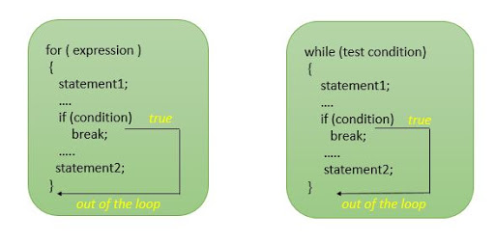

Slide 39
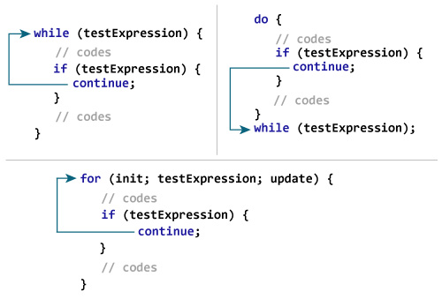

Slide 40
continue
Skips the remaining statements in the body of a while, for or do…while statement and proceeds with the next iteration of the loop
while and do…while
Loop-continuation test is evaluated immediately after the continue statement is executed.
for
Increment/ decrement expression is executed first, then the loop-continuation test is evaluated.

Slide 41
Continue (example)
#include<stdio.h>
int main()
{
int i,n,sum=0;
for(i=1;i<=10;i++)
{
if(i%2 == 0)
continue;
printf("\n %d is summing",i);
sum = sum + i;
}
printf("\nSummation is: %d",sum);
return 0;
}

Slide 42
Continue (example)
#include<stdio.h>
int main()
{
int i,j=0,count=0,sum=0;
for(i=1;i<=15;i++)
{
count = i;
if(count <= 10)
{
j++;
continue;
}
sum = sum + count;
}
printf("\n Summation = %d",sum);
printf("\n j = %d",j);
return 0;
}

Slide 43
break
Causes immediate exit from a while, for, do…while or switch statement.
Program execution continues with the first statement after the control structure.
Common uses of the break statement
- Escape early from a loop
- Skip the remainder of a switch statement

Slide 44
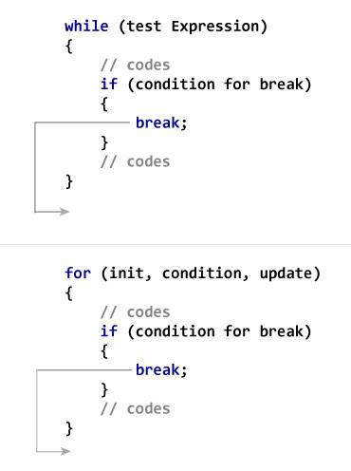
Break (cont…)

Slide 45
Break (Example)
#include<stdio.h>
int i, sum=0; for( i=1 ; ; i++ ) { sum += i; if( sum >= 10 )
{ break;
} }

Slide 46
Prime Number Between a Range:
#include <stdio.h>
int main()
{
int low, high, i, flag;
printf("Enter two numbers(intervals): ");
scanf("%d %d", &low, &high);
printf("Prime numbers between %d and %d are: \n", low, high);
while (low < high)
{
flag = 0;
for(i = 2; i <= low/2; ++i)
{
if(low % i == 0)
{
flag = 1;
break;
}
}
if (flag == 0)
printf("%d \n", low);
++low;
}
return 0;
}

